Slide 1



WPS
Swagger UI
2
0
2
5
CAMPUS
API
Education
API for Managing Courses & Faculty using FastAPI
Name :Sanjai B
Date: 19.07.2025
CAMPUS API EDUCTION

Slide 2




Table Of Contents
01 part
02 part
03 part
04 part
Overview & Features
Project Structure
Data Models
Core API Endpoints (Courses & Faculty)
05 part
06 part
07 part
08 part
Advanced Analytics
Setup Instructions
Live Demo Use Cases
Key Takeaways & Future Scope
CAMPUS API EDUCTION

Slide 3

01
Thesis Defense
What is the Campus API?
CAMPUS API EDUCATION

Slide 4

What is Campus API
1
A RESTful API built with FastAPI and Pydantic
2
Manages data for:
-Courses
-Faculty
3
CRUD operations, advanced queries, fuzzy search
4
Stores data in JSON files for testing/mock storage and Auto-generated Swagger docs at /docs

Slide 5



Research Topic
Briefly elaborate on what you want to discuss.
Title here
Title here
Title here
Title here
Making presentations powerful tools.
Making presentations powerful tools.
Making presentations powerful tools.
Making presentations powerful tools.

Slide 6


Research Topic
Briefly elaborate on what you want to discuss.
A picture is worth a thousand words
^{70%}
Briefly elaborate on what you want to discuss.
Making presentations powerful tools for convincing and teaching. Making presentations powerful tools for convincing and teaching.
Title here
Making presentations powerful tools for convincing and teaching.
Title here
Title here
Making presentations powerful tools for convincing and teaching. Making presentations powerful
Making presentations powerful tools for convincing and teaching. Making presentations powerful

Slide 7
02
Thesis Defense
🧱 Project Files & Structure
CAMPUS API EDUCATION

Slide 8
main.py:
Initializes the FastAPI app and registers all route modules (courses, faculty, advanced). It also serves a simple homepage with links to Swagger/docs.
database.py:
Handles loading and saving of mock JSON data (courses.json, faculty.json) and provides utility functions to fetch individual records from memory.
models.py:
Defines the Pydantic data models (Course, Faculty) used for request validation and response serialization across the entire API.
routers/courses.py:
Implements all course-related API operations including CRUD, search, filtering, recommendations, specialization matching, and advanced analytics (e.g. most prerequisites).
routers/faculty.py:
Implements faculty-related API operations including CRUD, fuzzy search, availability, contact directory, section-wise filtering, and advanced faculty analytics.
routers/advanced.py:
Contains cross-domain analytic features and advanced filters such as department course counts, global search, and credit-based filtering.
mock_data/courses.json:
Stores mock course records including course details, prerequisites, and lead faculty IDs; used to simulate a working database.
mock_data/faculty.json:
Stores mock faculty information including departments, specialization, availability, and linked courses; used for testing and response data.
mock_data_generator.py:
Automatically generates realistic mock data for both courses.json and faculty.json using the faker package; saves time when testing the full API.

Slide 9
03
Thesis Defense
Data Models
Course & Faculty Models
CAMPUS API EDUCATION

Slide 10

COURSE AND FACULTY MODELS
class Course(BaseModel):
id: int
name: str
code: str
description: str
credits: int
department: str
prerequisites: List[int]
faculty_id: int
class Faculty(BaseModel):
id: int
first_name: str
last_name: str
email: str
department: str
specialization: List[str]
office_location: str
office_hours: str

Slide 11


04
Thesis Defense
Core API Endpoints (Courses & Faculty)
CAMPUS API EDUCATION

Slide 12
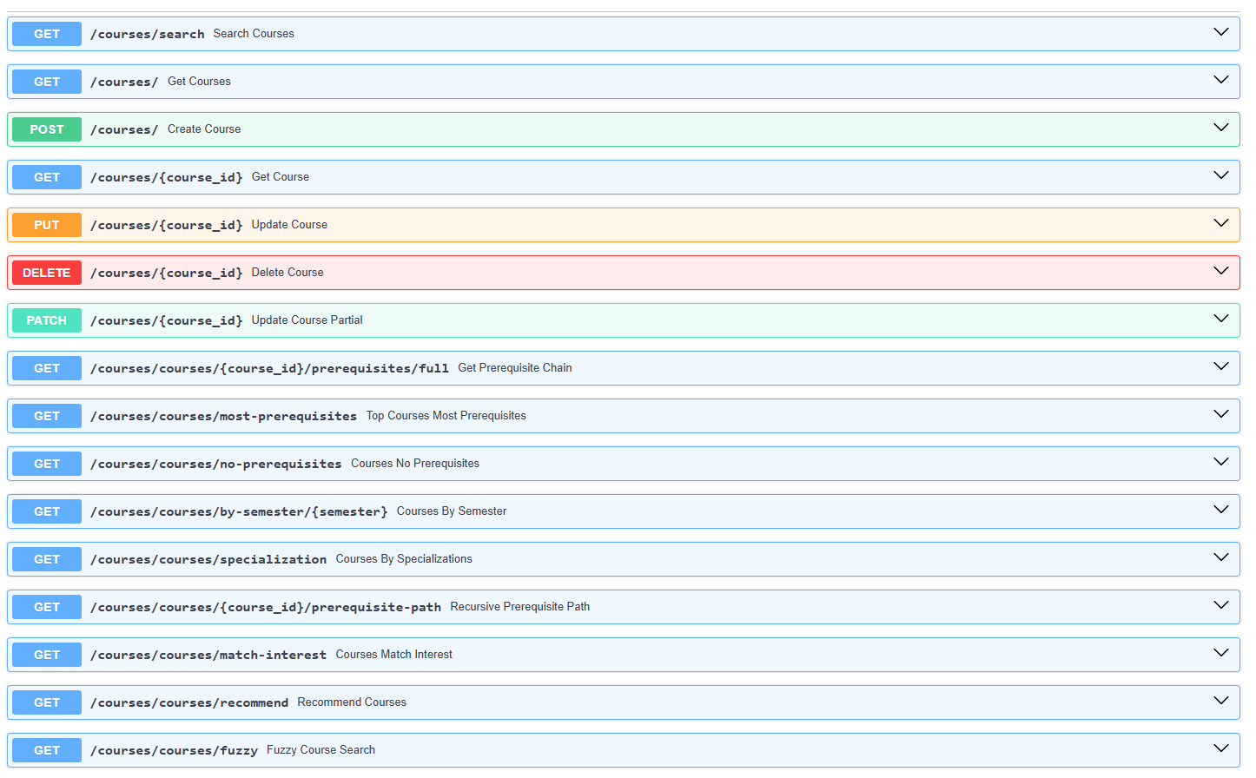
COURSES

Slide 13
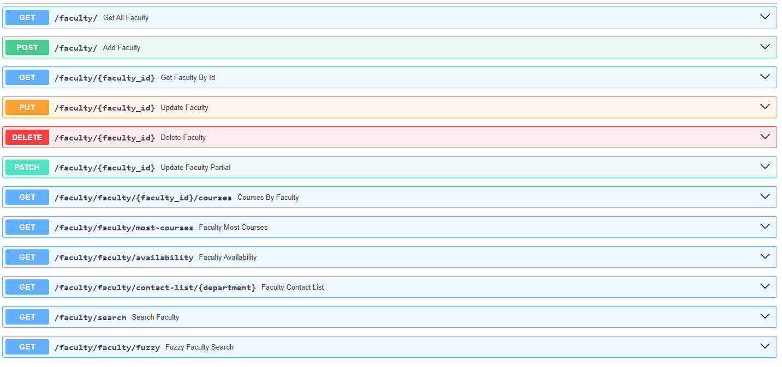
FACULTY

Slide 14
05
Thesis Defense
Advanced Analytics Endpoints
CAMPUS API EDUCATION

Slide 15
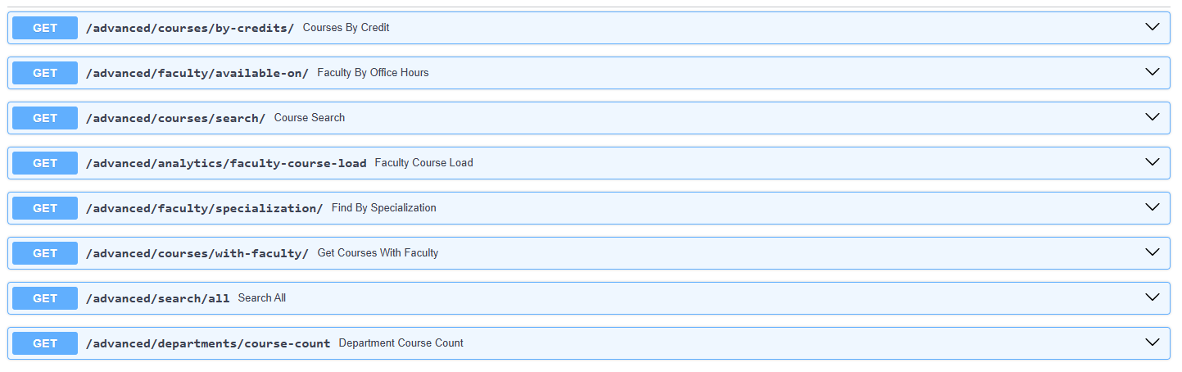
ADVANCED STATISTICS & FILTERS

Slide 16
06
Thesis Defense
Setup instructions
CAMPUS API EDUCATION

Slide 17

Steps
Install dependencies:
Go to folder with main.py
pip install -r requirements.txt
01
cd app
04
02
Explore Docs or Redoc:
Run Server
03
http://localhost:8000/docs
or
http://localhost:8000/redoc
uvicorn main:app --reload

Slide 18
07
Thesis Defense
Use Cases
You can enter a subtitle here if you need it

Slide 19

Use Cases
Course recommendation system for students
Student/Faculty portal connector
Real-time search assistant for courses & faculty
Integrated into a College Content Management System

Slide 20
08
Thesis Defense
Key Takeaways and Future scope
You can enter a subtitle here if you need it

Slide 21

Validation & 422 Errors
Type Enforcement:
FastAPI automatically checks if inputs match the expected data types using Pydantic and Python type hints.
1
422 Error Response:
Invalid or missing input returns a 422 Unprocessable Entity with details explaining the validation error.
2
Applies to All Inputs:
Validation applies to query parameters, path variables, and request bodies to ensure clean and correct data.
3

Slide 22

Key Takeaways
01
FastAPI enables rapid development of robust, type-safe REST APIs with built-in documentation.
02
The College Campus API supports full CRUD operations with advanced search and analytics.
03
Title here
REST APIs provide a standardized way for different applications to communicate and exchange data reliably over the web, enabling integration between diverse systems and technologies.

Slide 23
WPS
Thesis Defense
2
0
X
X
THANK YOU
Research
Education
It serves a variety of purposes, making presentations powerful tools for convincing and teaching.
Speaker name :XXX
Date:20XX.01.01
You can enter a subtitle here if you need it

